Slide 2
Topic: Improved DDPM for Image Inpainting
My Pitch
---- Experiment with CelebA dataset
Jiayi Lu - s242648

Slide 3
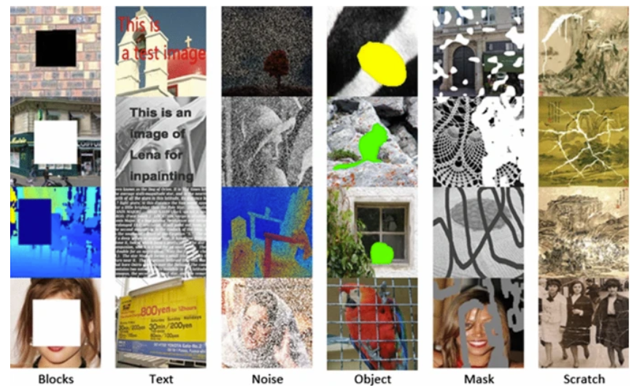
Introduction
The objective of image inpainting is to fill missing parts of an image. Current state-of-the-art approaches often rely on GANs^{[1]} or Auto-regressive Modeling^{[2]}. Luckily, Denoising Diffusion Probabilistic Models(DDPM)^{[3]}, an emerging alternative paradigm for generative modelling, lays the solid foundation to solve image inpainting tasks. Based on DDPM, we have improved it to fit into image inpainting.

Slide 4
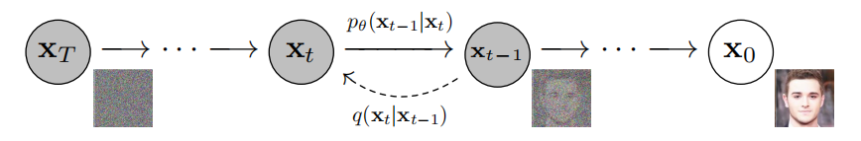
DDPM Introduction
Forward process
If we define , we can get:
Reverse process
Markov chain of adding noise and denoising

Slide 5
The training objective
parameterize the reverse process and the brief training objective for DDPMs is:
Note: DDPMs require many sampling steps(typically 1000 or even more) to generate high-quality samples, making them very computationally intensive for practical applications. Thus, we use DDIM sampling, which will faster sampling than traditional DDPM.

Slide 6
Image Inpainting with DDPM
In image inpainting tasks, we are given a corrupted image x_corrupt with missing regions and a binary mask M (with 1s indicating known pixels and 0s for missing ones). We aim to generate the complete image x_complete where:
x_corrupt = M ⊙x_complete
The reverse diffusion process for inpainting is modified to enforce the consistency of the known regions during sampling. At each denoising step, we apply the constraint:
x_(t−1) ← M ⊙x_known + (1 − M ) ⊙ x_(t−1)
where x_known represents the known pixels from the corrupted image, properly scaled according to the noise level at timestep t−1. This constraint is applied at every denoising step to ensure that the generated content matches the uncorrupted areas.

Slide 7
The Mask-dependent Noise Schedule
We have applied adaptive noise schedule to known and unknown schedule:
Known area(1-M): linear noise schedule
Unknown area(M): cosine noise schedule
Noise( ) Schedule:
Linear noise: increases linearly from to :
Cosine noise: use a cosine function to create a smooth schedule:

Slide 8
Our Model
U-net based diffusion model
The backbone architecture for most diffusion models is a U-Net^{[4]}, which has proven effective for image-to-image translation tasks. The U-Net consists of:
1. An encoder path that downsamples the input image through convolutional layers
2. A bottleneck at the lowest resolution
3. A decoder path that upsamples back to the original resolution
4. Skip connections that connect corresponding layers in the encoder and decoder
Some modifications:
Timestep Embedding
A critical component is the embedding of the timestep t, which informs the network about the noise level it is trying to remove. The timestep is typically embedded using sinusoidal positional embeddings similar to those used in Transformer models.
Self-Attention Layers
To capture long-range dependencies, self-attention layers are often incorporated at one or more resolutions, typically in the bottleneck of the U-Net.

Slide 9
Component | Channels | Resolution (input 64×64)
Input | in_channels | 64×64
Initial Conv (e1) | 64 | 64×64
Down Block 1 (e2) | 128 | 32×32
Down Block 2 (e3) | 256 | 16×16
Middle Block | 256 | 16×16
Up Block 1 (d1) | 128 | 32×32
Up Block 2 (d2) | 64 | 64×64
Output Conv (d3) | out_channels | 64×64
Table: Detailed U-Net architecture specifications for diffusion models

Slide 10
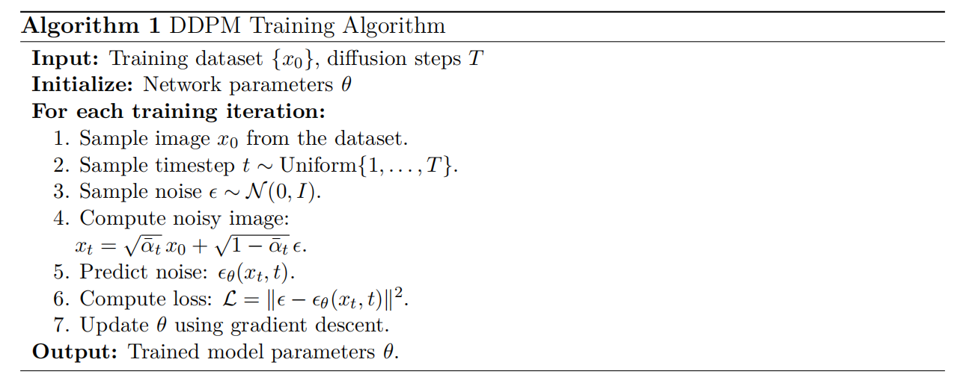
DDPM Training Process Pseudocode

Slide 11
The Loss Function
Instead of simple loss function, we use effective Composite Loss Function, which is a weighted combination of losses.
Perceptual losses capture high-level semantic features by utilizing pretrained networks
Adversarial training can significantly improve the realism of inpainted regions
represents additional regularization terms that might be beneficial for specific inpainting scenarios.

Slide 12
Inplementation Using CelebA^{[10]} dataset
Preprocess the dataset
Normalization:
Normalize pixel values to a range suitable for the network
(e.g., [-1,1]).
Crop and Resize:
Crop faces and resize images to a fixed resolution (e.g., 64×64, 128×128).

Slide 13
Our critical Hyperparameters/Configurations
Learning rate:
Appropriate learning rate scheduling is critical for diffusion models. We use dynamic learning rate to monitor the training process of DDPM.
Types of Mask:
We generate random masks for inpainting training, including "random", "center", "brush", and "half".
Adaptive Noise schedule
DDIM sampling strategy(less sampling steps)
Hyperparameter |  | Hyperparameter
 | 1*10⁻⁴ | Noise Schedule | adaptive
 | 0.02 | Network depth | 3-5 per resolution
Learning Rate | “warm_up cosine” | Image Size | 64*64
Batch Size | 32 | epochs | 100
Attention Heads | 8-16 | In_channels | 7
Diffusion Steps | 1000 | out_channels | 3

Slide 14
Evaluation Metrics
FID^{[4]}:
Fréchet Inception Distance(FID), a popular deep metric for perceptual rationality, measures the distance between the feature distributions of real and inpainted images. Lower is better.
Note: and are covariance matrix of the set of eigenvectors.
LPIPS^{[9]}:
Learned Perceptual Image Patch Similarity(LPIPS), a deep learning distance metric based on the deep feature space of pretrained AlexNet.(There is other options, such as VGG.)

Slide 15
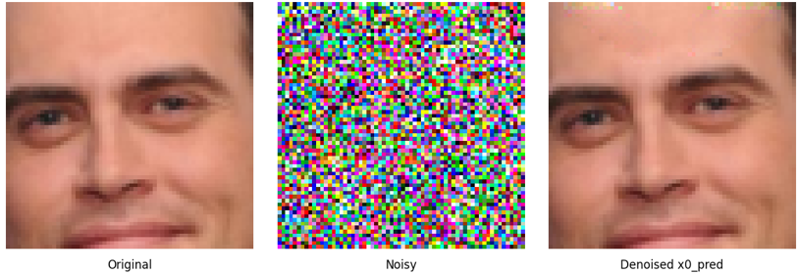
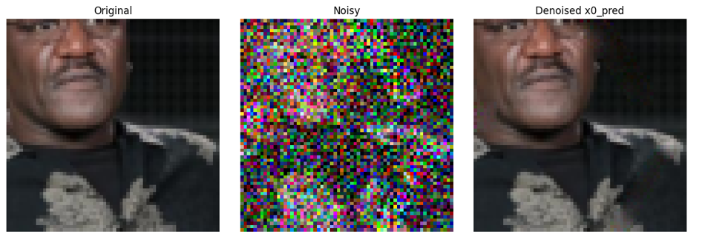
Visualization on CelebA dataset

Slide 16
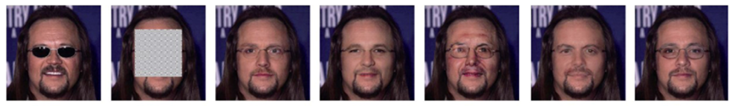
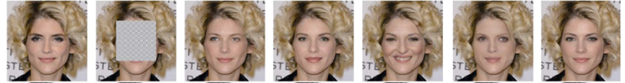
Evaluation/Results
Ground Truth
Input
DSI
LaMa
GANs
Repaint
Ours
Note: For convenience, we compare our approach against several state-of-the-art inpainting methods:
the autoregressive method DSI^{[5]}, and the GAN methods^{[6]}, LaMa^{[7]} and DDPM-based Repaint^{[8]}. All implemented on HPC NVIDIA GPU V-100.

Slide 17
Image Inpainting Methods Comparison
Methods | Best FID | LPIPS
GAN-based | 17.26 | 0.102
Autoregressive(DSI) | 16.69 | 0.078
LaMa | 12.03 | 0.062
Repaint | 8.52 | 0.061
Ours | 5.18 | 0.059
Comparison between the proposed method and the state-of-the-art

Slide 18
Improvements and Drawbacks
Improvements:
To reduce GPU memory consumption:
FID metric computation has moved from GPU to CPU.
with torch.no_grad(), optimizer.zero_grad(), torch.cuda.empty_cache() have been used.
Use proper batch=32
Distributed training strategies have been used (Data Parallelism)
Use adaptive noise schedule to known and unknown areas.
Use DDIM fast sampling; Use adaptive learning rate.
Use weighted composite loss function, traditional loss combined with VGG-loss.
Drawbacks:
Only use 46559 pictures out of 202599 pictures for faster training.
Not use ResnetBlock in Unet architecture
Fail to do the mask comparison due to training time limit
The generated images sometimes have a little noise. Maybe because of train with low resolution images.

Slide 19
Conclusion
Inpainting with Improved DDPMs on the CelebA dataset demonstrates the power of diffusion models in generating realistic image completions. Despite some challenges, the model’s ability to handle inpainting tasks with fine details and varying mask structures shows great promise for future applications in image restoration, editing, and synthesis tasks. With further optimization and fine-tuning, Improved DDPMs have the potential to become a leading model for high-quality inpainting in the field of generative image models.

Slide 20
References
[1] Pouget-Abadie J. Mirza M. Xu B. Warde-Farley D. Ozair S. ... Bengio Y. Good-fellow, I. Generative adversarial nets. Advances in neural information processing systems, 27, 2014.
[2] Rongliang Wu, Jianxiong Pan, Kaiwen Cui, Shijian Lu, Feiying Ma. Diverse image inpainting with bidirectional and autoregressive transformers. In Proceedings of the 29th ACM International Conference on Multimedia, 2021.
[3] Jonathan Ho, Ajay Jain, and Pieter Abbeel. Denoising diffusion probabilistic models. Advances in Neural Information Processing Systems, 33:6840–6851, 2020.
[4] Martin Heusel, Hubert Ramsauer, Thomas Unterthiner, Bernhard Nessler, and Sepp Hochreiter. Gans trained by a two time-scale update rule converge to a local nash equilibrium. Advances in Neural Information Processing Systems, 30, 2017.
[5] Jialun Peng, Dong Liu, Songcen Xu, and Houqiang Li. Generating diverse structure for image inpainting with hierarchical VQ-VAE. In Proceedings of the IEEE/CVF Conference
on Computer Vision and Pattern Recognition, pages 10775–10784, 2021.
[6] Yanhong Zeng, Jianlong Fu, Hongyang Chao, and Baining Guo. Aggregated contextual transformations for highresolution image inpainting. IEEE Transactions on Visualization and Computer Graphics, 2022.

Slide 21
[7] Roman Suvorov, Elizaveta Logacheva, Anton Mashikhin, Anastasia Remizova, Arsenii Ashukha, Aleksei Silvestrov, Naejin Kong, Harshith Goka, Kiwoong Park, and Victor Lempitsky. Resolution-robust large mask inpainting with fourier convolutions. In Proceedings of the IEEE/CVF Winter Conference on Applications of Computer Vision, pages 2149–2159, 2022.
[8] Andreas Lugmayr, Martin Danelljan, Andres Romero, Fisher Yu, Radu Timofte, and Luc Van Gool. RePaint: Inpainting using denoising diffusion probabilistic models. In Proceedings of the IEEE/CVF Conference on Computer Vision and Pattern Recognition, pages 11461–11471, 2022.
[9] Richard Zhang, Phillip Isola, Alexei A Efros, Eli Shechtman, and Oliver Wang. The unreasonable effectiveness of deep features as a perceptual metric. In Proceedings of the IEEE Conference on Computer Vision and Pattern Recognition, pages 586–595, 2018.
[10] Liu, Ziwei and Luo, Ping and Wang, Xiaogang and Tang, Xiaoou. Deep Learning Face Attributes in the Wild. Proceedings of International Conference on Computer Vision (ICCV), December 2015.

Slide 22
Statement of the use of GenAI
Debug the channel of neural network in Unet and training process
Ask about composite loss function
Solutions to lack of GPU memory in HPC

Slide 23
Thank you for listening!

